Slide 1
Awful to Awe Full
A Unique Take on the Effects of Serotonergic Psychedelics
Jazmine Yaeger

Slide 2
Serotonergic Psychedelics Produce Awe
A feeling:
Reverence
Admiration/Adoration
Wonder
Fear
Someone
or Something
Awe is part of the subjective experience

Slide 3
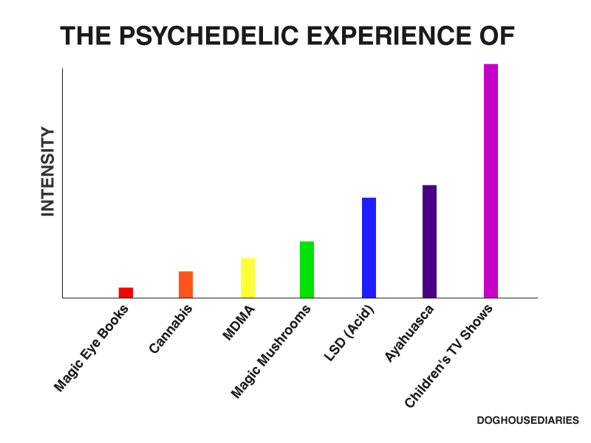
Serotonergic Psychedelic: Subjective Experience

Slide 4
Serotonergic Psychedelic: Subjective Experience
Can we relate subjective experiences to biology and behavior?

Slide 5
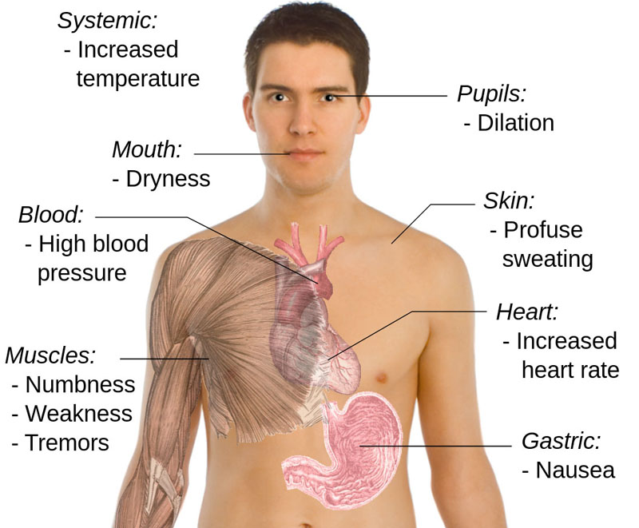
Serotonergic Psychedelic: Physical Experience

Slide 6
Serotonergic Psychedelic: Physical Experience
Sleep Paralysis
DMT
Muscle Tone
Psilocybin
Muscle Rigidity

Slide 7
Let’s Explore…
Serotonergic psychedelics can promote Awe
Serotonergic psychedelics can induce changes in muscle tone
The circuits mediating these effects are similar (if not identical)

Slide 8
Predictions…
Pathways related to Awe & changes in muscle tone →
Gated by interconnected mechanisms in the amygdala…
These mechanisms include serotonergic action→
Can be manipulated with psychedelics…
Psychedelics may exhibit therapeutic potential through these pathways

Slide 9
Can Awe be Measured?
Novelty:
Learning Signal
Attracts Attention
Promotes Memory Encoding
Modifies Goal-Directed Behavior
Focuses Motivation
Novelty is related to Awe
Bunzeck, N., et al. (2012). "Contextual interaction between novelty and reward processing within the mesolimbic system." Human brain mapping 33(6): 1309-1324.

Slide 10
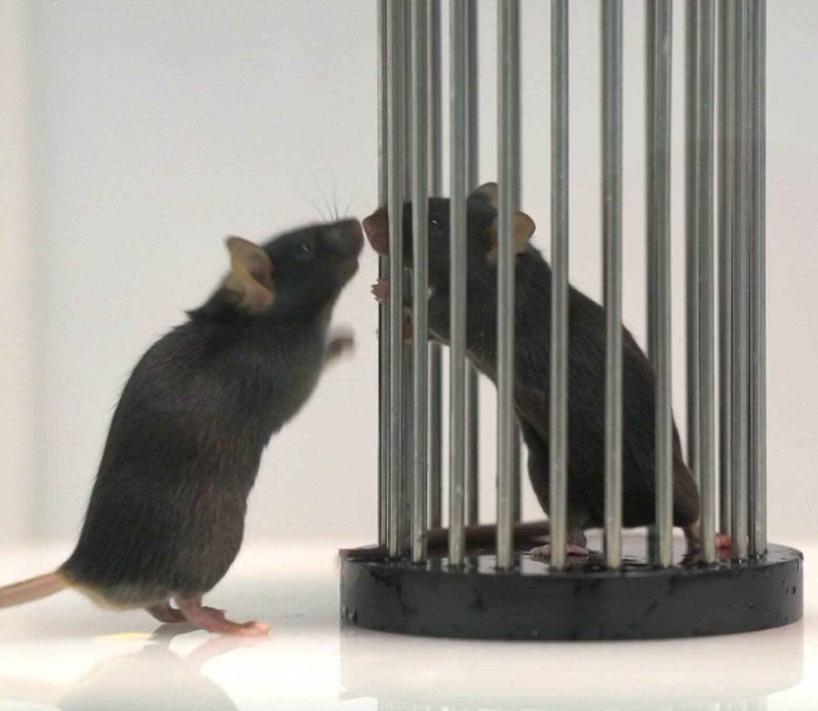
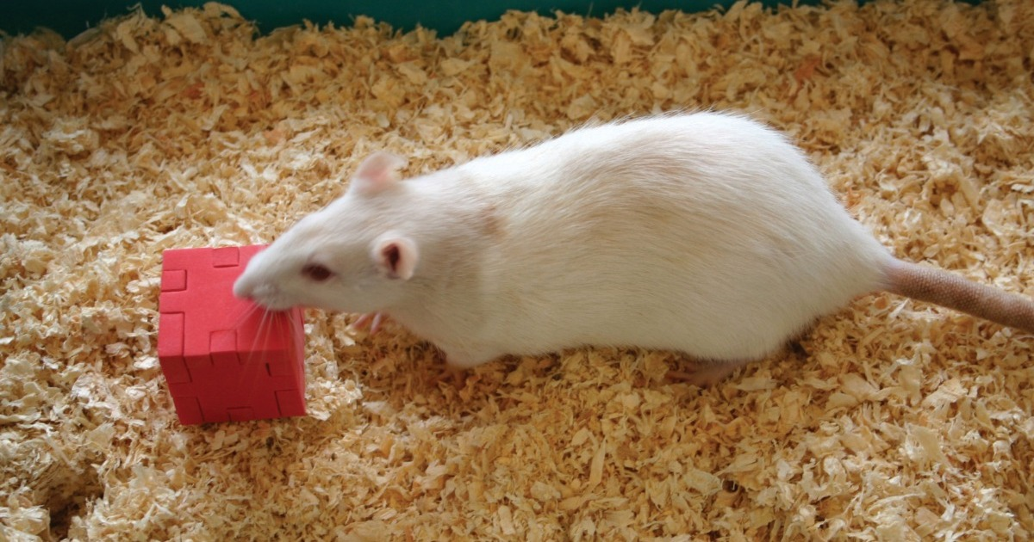
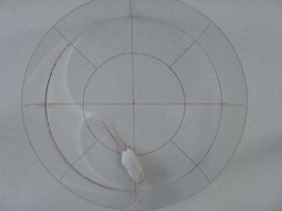
Assessing Novelty Exploration in Rodents
Social Novelty
Object Novelty
Spatial Novelty

Slide 11
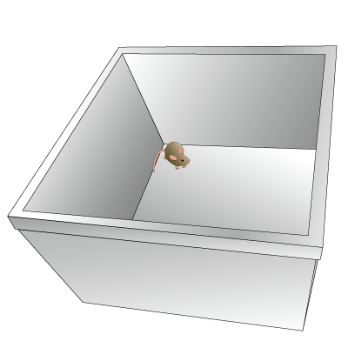
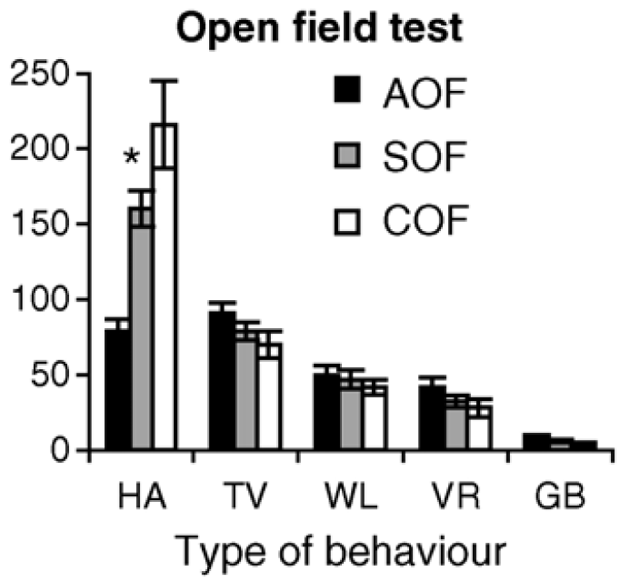
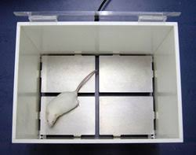
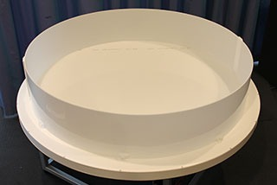
Assessing Novelty Exploration in Rodents
Gridded Open Field (Actimeter)
Square Open Field
Frequency of Behavior
Circular Open Field
Kalueff, A. V., et al. (2006). "Temporal stability of novelty exploration in mice exposed to different open field tests." Behavioural Processes 72(1): 104-112.

Slide 12
Assessing Novelty Exploration in Rodents
Botta, P., et al. (2019). "An amygdala circuit mediates experience-dependent momentary exploratory arrests." bioRxiv: 797001.

Slide 13
Assessing Novelty Exploration in Rodents
Novelty drives exploration in rodents…
What about serotonergic psychedelics?
Botta, P., et al. (2019). "An amygdala circuit mediates experience-dependent momentary exploratory arrests." bioRxiv: 797001.

Slide 14
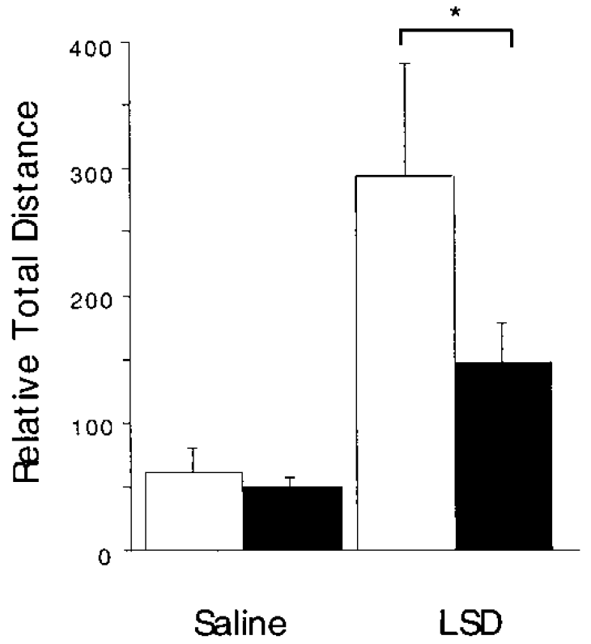
Serotonergic Psychedelics Increase Exploration
What about the circuitry involved in this behavior?
Grailhe, R., et al. (1999). "Increased exploratory activity and altered response to LSD in mice lacking the 5-HT5A receptor." Neuron 22(3): 581-591.
Notes:
LSD did not affect home cage mobility.

Slide 15
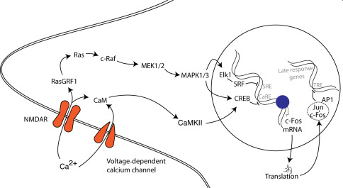
Novelty Perception
dmPFC = Anterior Cingulate Cortex & Prelimbic Cortex
vmPFC = Medial Orbitofrontal Cortex & Infralimbic Cortex
ACC and PrL important for novelty exploration?
c-Fos is an Immediate Early Gene
Hervig, M. E.-S., et al. (2017). "Involvement of serotonin 2A receptor activation in modulating medial prefrontal cortex and amygdala neuronal activation during novelty-exposure." Behavioural Brain Research 326: 1-12.
Notes:
Somatosensory Cortex as Control

Slide 16
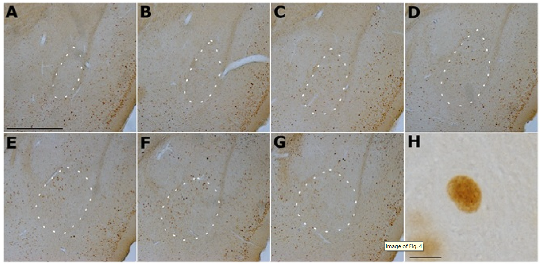
Novelty Perception
Basolateral Amygdala (BLA) involved in Novelty Exploration?
Hervig, M. E.-S., et al. (2017). "Involvement of serotonin 2A receptor activation in modulating medial prefrontal cortex and amygdala neuronal activation during novelty-exposure." Behavioural Brain Research 326: 1-12.

Slide 17
Novelty Perception
Novelty Definition:
Learning Signal
Attracts Attention
Promotes Memory Encoding
Modifies Goal-Directed Behavior
Focuses Motivation
Descriptions fit researched roles of PFC and Amygdala

Slide 18
Novelty Perception
dmPFC
Amygdala

Slide 19
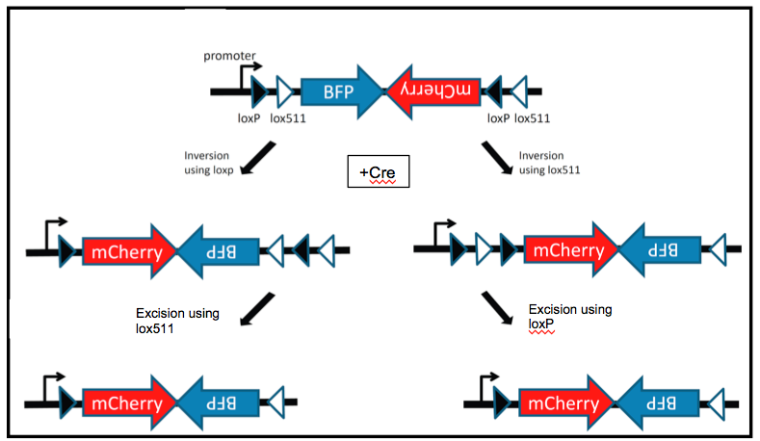
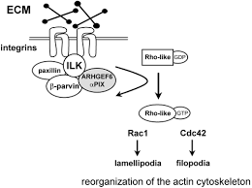
Targeting Specific BLA Cells
NL189 Mice
AAV1-CAG-FLEX-Tdtomato
Express Cre under the control of ARhGEF6 promoter
Adeno-Associated Virus Serotype 1
CMV Promoter + Enhancer Elements from Beta-Actin (Chicken)
Conditional Gene Expression Sequence
Rho Guanine Nucleotide Exchange Factor 6
Protein Reporter
Rosenberger, G., et al. (2003). Hum Mol Genet 12(2): 155-167.
Notes:
ARHGEF6 (Rac/Cdc42 Guanine Nucleotide Exchange Factor 6) is a Protein Coding gene. Diseases associated with ARHGEF6 include Non-Syndromic X-Linked Intellectual Disability and Syndromic X-Linked Intellectual Disability. Among its related pathways are Signaling by GPCR and Regulation of CDC42 activity. Gene Ontology (GO) annotations related to this gene include GTPase activator activity and Rho guanyl-nucleotide exchange factor activity. An important paralog of this gene is ARHGEF7.

Slide 20
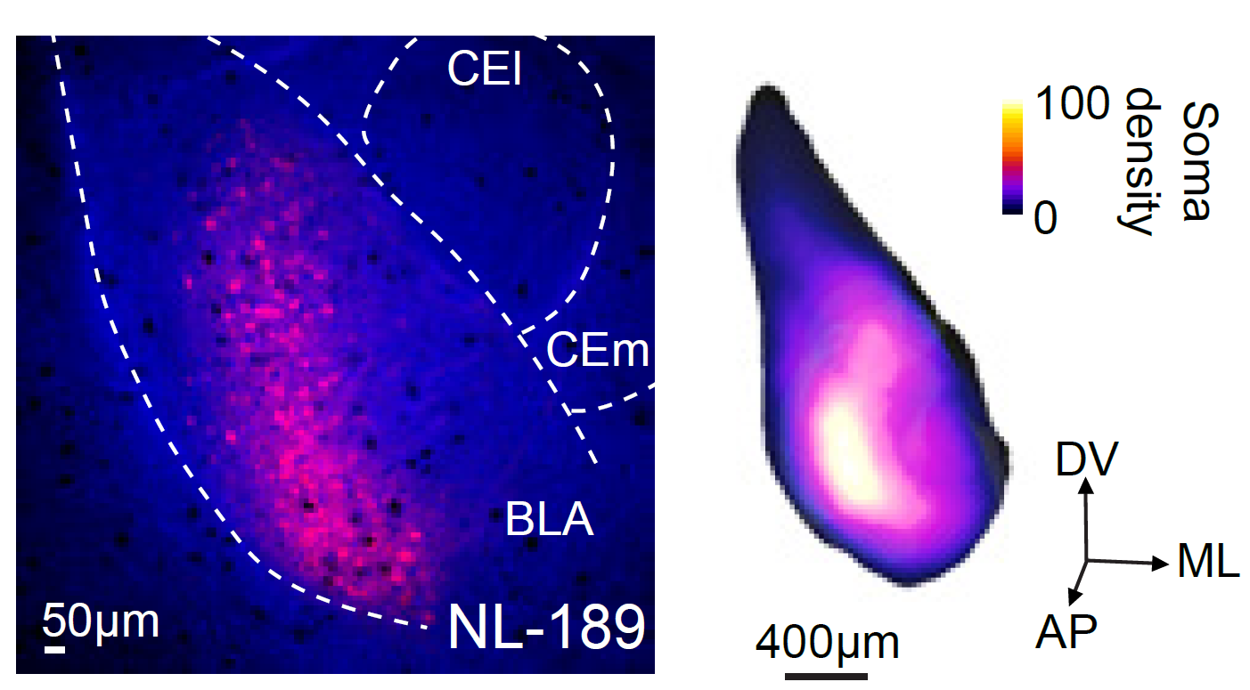
Targeting Specific BLA Cells
NL189 Mice
AAV1-CAG-FLEX-Tdtomato
Botta, P., et al. (2019). "An amygdala circuit mediates experience-dependent momentary exploratory arrests." bioRxiv: 797001.

Slide 21
Targeting Specific BLA Cells
A subset of BLA pyramidal neurons express ARhGEF6
How are these cells related to exploratory behavior?
Botta, P., et al. (2019). "An amygdala circuit mediates experience-dependent momentary exploratory arrests." bioRxiv: 797001.

Slide 22
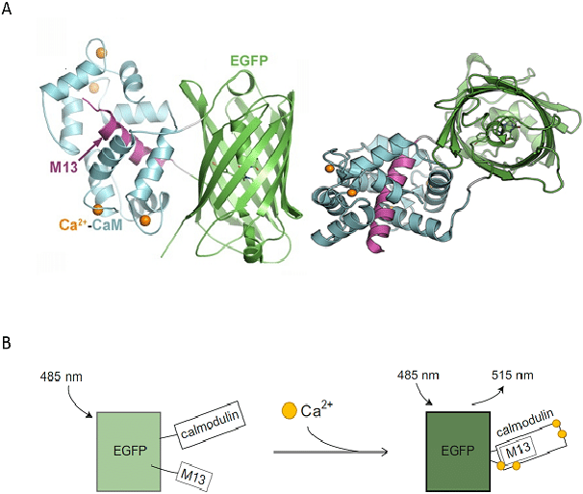
Specific BLA Cells and Exploration
AAV5-CAG-FLEX-GCaMP6f-WPRE
Adeno-Associated Virus Serotype 5
CMV Promoter + Enhancer Elements from Beta-Actin (Chicken)
Conditional Gene Expression Sequence
Fluorescent Ca²⁺ Indicator
Woodchuck Hepatitis Virus Posttranscriptional Regulatory Element
= Constrained Nonnegative Matrix Factorization
Gheisari, A. (2017). Novel Tools for Simultaneous Optogenetic Manipulation and Calcium Imaging in the Zebrafish Nervous System.

Slide 23
Specific BLA Cells and Exploration
Time →
Botta, P., et al. (2019). "An amygdala circuit mediates experience-dependent momentary exploratory arrests." bioRxiv: 797001.

Slide 24
Specific BLA Cells and Exploration
AAV1-EF1α-DIO-hChR2-YFP
Adeno-Associated Virus Serotype 1
Elongation Factor 1 alpha promoter
Conditional Gene Expression Sequence (Double-floxed Inverse Orientation)
Human Channel Rhodopsin 2 (465 nm)
Yellow Fluorescent Protein Reporter
AAV5-CAG-FLEX-Jaws-KGC-tdTomato-ER2
Adeno-Associated Virus Serotype 5
CMV Promoter + Enhancer Elements from Beta-Actin (Chicken)
Conditional Gene Expression Sequence
Halo Rhodopsin 57 (630 nm)
Fusion Protein (trafficking protein)
Protein Reporter
Fusion Protein (trafficking protein)
Botta, P., et al. (2019). "An amygdala circuit mediates experience-dependent momentary exploratory arrests." bioRxiv: 797001.
Notes:
Fusion Proteins – used to improve membrane expression

Slide 25
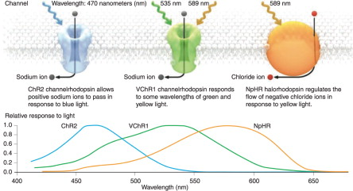
Specific BLA Cells and Exploration

Slide 26
Specific BLA Cells and Exploration
or inhibition
Botta, P., et al. (2019). "An amygdala circuit mediates experience-dependent momentary exploratory arrests." bioRxiv: 797001.
Notes:
Activated when animal had accelerated for 100 ms – LED was on for around 33% of the time, remaining 66% served as within-animal controls

Slide 27
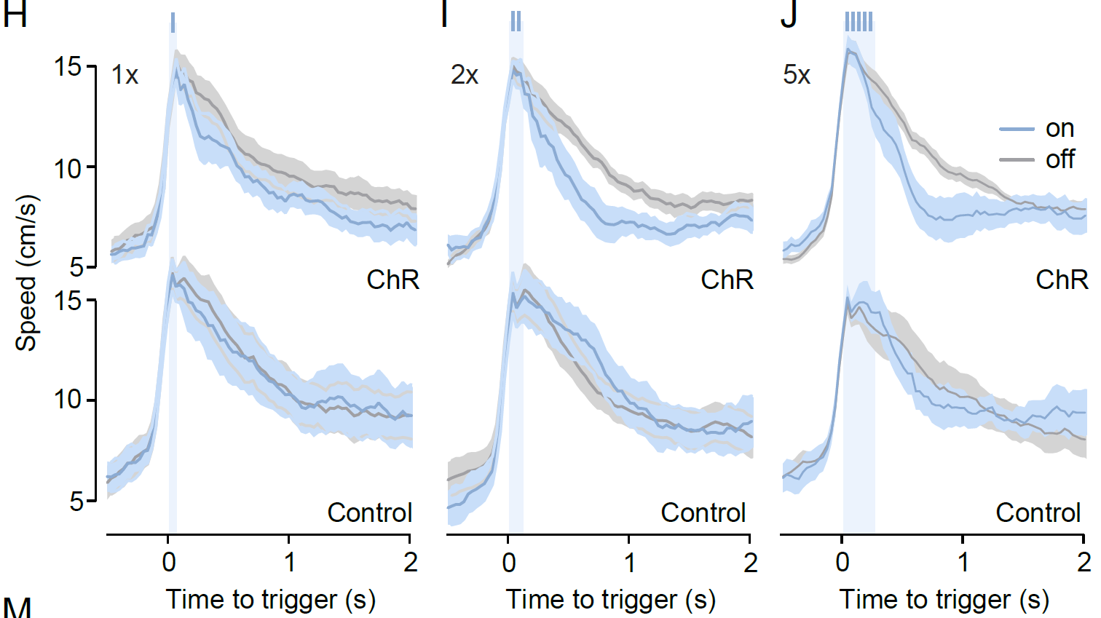
Specific BLA Cells and Exploration
Botta, P., et al. (2019). "An amygdala circuit mediates experience-dependent momentary exploratory arrests." bioRxiv: 797001.

Slide 28
Specific BLA Cells and Exploration
Botta, P., et al. (2019). "An amygdala circuit mediates experience-dependent momentary exploratory arrests." bioRxiv: 797001.

Slide 29
So what?
PFC and BLA are important for novelty exploration
Activation of specific BLA pyramidal cells ↓ exploration speed
Inhibition of these neurons ↑ exploration speed
What does this have to do with serotonergic psychedelics...
or muscle tone?
Botta, P., et al. (2019). "An amygdala circuit mediates experience-dependent momentary exploratory arrests." bioRxiv: 797001.

Slide 30
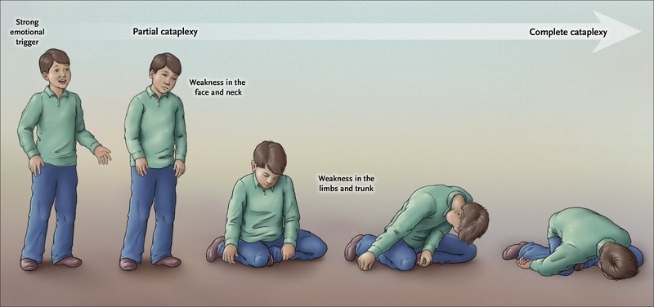
Cataplexy is a Loss of Muscle Tone
Sudden loss of muscle tone or paralysis
Triggered by strong emotional response or laughter
Linked to a loss or reduction in orexin
Neuropeptide produced in hypothalamus
Involved in:
Wakefulness
Arousal
Motivated Behaviors
Food-seeking
Symptom of Narcolepsy
Botta, P., et al. (2019). "An amygdala circuit mediates experience-dependent momentary exploratory arrests." bioRxiv: 797001.

Slide 31
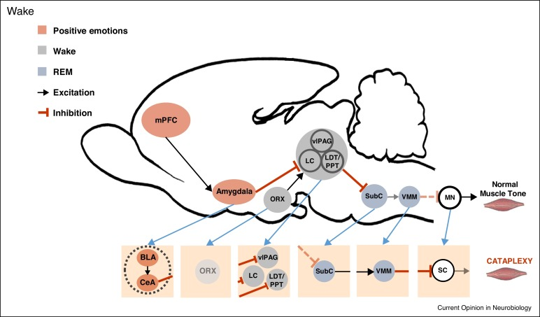
Cataplexy is a Loss of Muscle Tone
vlPAG = ventrolateral Periaqueductal Gray
LC = Locus Coeruleus
LDT/PPT = Laterodorsal Tegmentum/
Pedunculopontine Nuclei
This is a predicted circuit and NOT the full story
SubC= Subcoeruleus Nucleus
VMM= Ventromedial Medulla
MN= Motor Neurons
ORX = Orexin Neurons of the Lateral
Hypothalamus
Pintwala, S. and J. Peever (2017). "Circuit mechanisms of sleepiness and cataplexy in narcolepsy." Current opinion in neurobiology 44: 50-58.
Notes:
LDT = cholinergic
PPT = histaminergic
LC = adrenergic

Slide 32
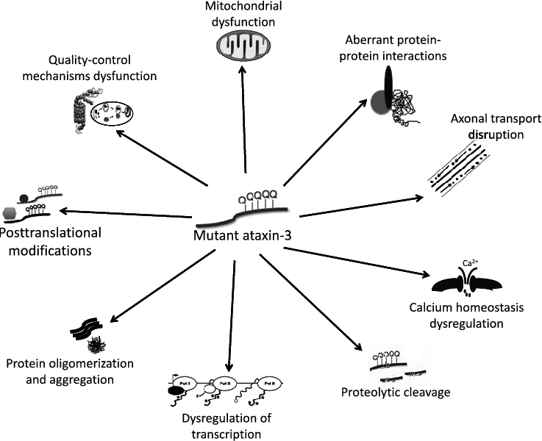
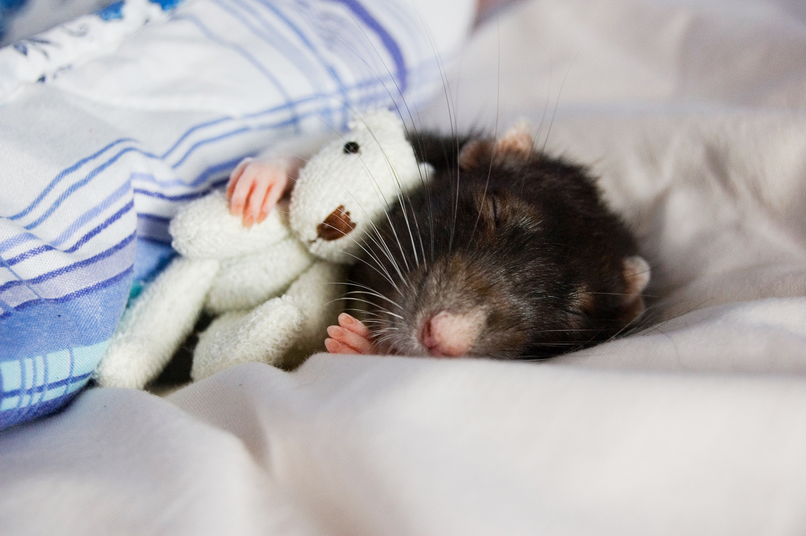
Cataplexy – More Pieces of the Full Story
Orexin-Ataxin3 Mice
Paulson, H. (2011). "Machado-Joseph Disease/Spinocerebellar Ataxia Type 3." Handbook of clinical neurology / edited by P.J. Vinken and G.W. Bruyn 103: 437-449.
Notes:
Machado-Joseph Disease autosomal dominant disease, meaning that if either parent gives the defective gene to a child, the child will show symptoms of the disease.
Patients with severe forms of MJD have a life expectancy of approximately 35 years. Those with mild forms have a normal life expectancy. The cause of death of those who die early is often aspiration pneumonia.
Symptoms begin early adolescents

Slide 33
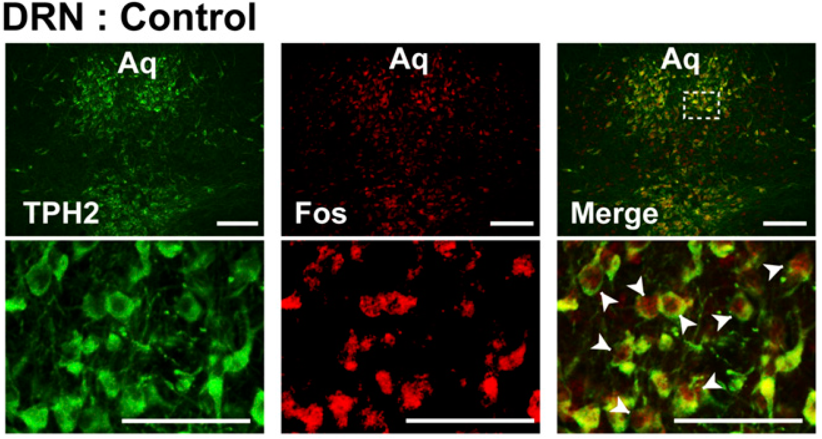
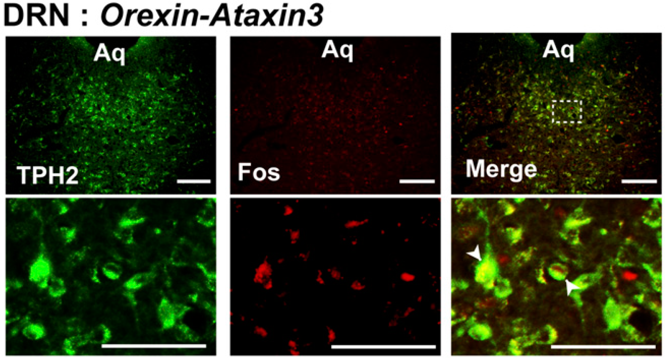
Cataplexy – More Pieces of the Full Story
Orexin signals and activates serotonin neurons
Hasegawa, E., et al. (2017). "Serotonin neurons in the dorsal raphe mediate the anticataplectic action of orexin neurons by reducing amygdala activity." Proceedings of the National Academy of Sciences 114(17): E3526.

Slide 34
Cataplexy – More Pieces of the Full Story
AAV2-EF1α-DIO-SSFO-EYFP
Adeno-Associated Virus Serotype 2
Elongation Factor 1 alpha promoter
Conditional Gene Expression Sequence (Double-floxed Inverse Orientation)
Stabilized Step-Function Opsin (630 nm)
Enhanced Yellow Fluorescent Protein
Hasegawa, E., et al. (2017). "Serotonin neurons in the dorsal raphe mediate the anticataplectic action of orexin neurons by reducing amygdala activity." Proceedings of the National Academy of Sciences 114(17): E3526.
Notes:
While the rapid activation and deactivation kinetics of ChR2 are advantageous in some experiments, other studies require stable neuronal activation over longer periods. To achieve this using ChR2 would require lengthy illumination of tissue, which can lead to damage due to overheating. To overcome this problem, a class of opsins known as step-function opsins (SFOs) has been developed. A single pulse of blue light switches the SFO channel to an open state, and this is maintained for up to a minute once the light has been switched off (alternatively, a single pulse of yellow light can close the channel). Stabilized step-function opsins (SSFOs) extend this principle even further, allowing stable activation of neurons several millimeters below the brain surface using only a brief, low-intensity pulse of light. The channel deactivation time constant of SSFOs is roughly 29 minutes

Slide 35
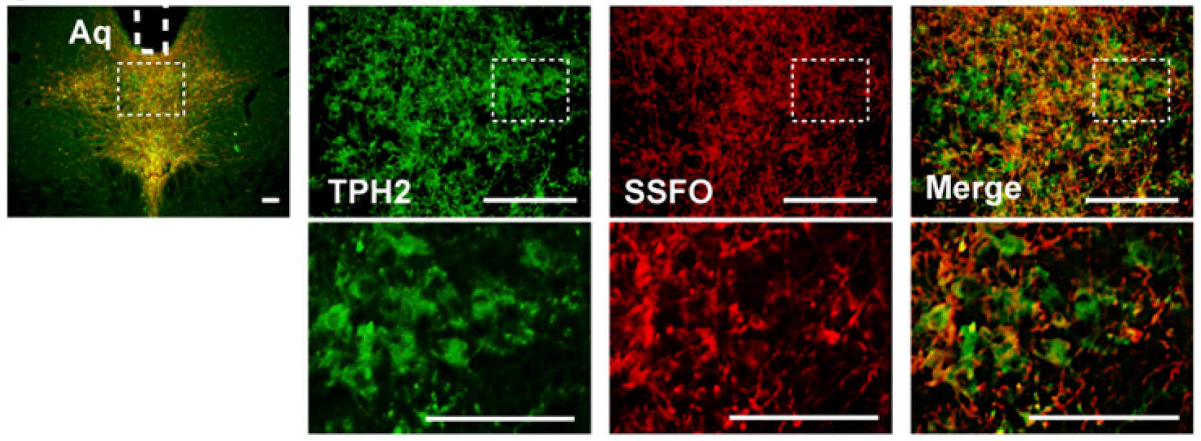
Cataplexy – More Pieces of the Full Story
Orexin-Ataxin3 Mice
= Cataplexy-Like Episodes
Serotonergic Cells Regulate Cataplexy
But what about the cataplexy circuit?
DRN
Hasegawa, E., et al. (2017). "Serotonin neurons in the dorsal raphe mediate the anticataplectic action of orexin neurons by reducing amygdala activity." Proceedings of the National Academy of Sciences 114(17): E3526.

Slide 36
Cataplexy – More Pieces of the Full Story
X
Pintwala, S. and J. Peever (2017). "Circuit mechanisms of sleepiness and cataplexy in narcolepsy." Current opinion in neurobiology 44: 50-58.
Notes:
LDT = cholinergic
PPT = histaminergic
LC = adrenergic

Slide 37
Cataplexy – More Pieces of the Full Story
DR
Hasegawa, E., et al. (2017). "Serotonin neurons in the dorsal raphe mediate the anticataplectic action of orexin neurons by reducing amygdala activity." Proceedings of the National Academy of Sciences 114(17): E3526.

Slide 38
So what?
Amygdala is important for both novelty exploration & cataplexy
↑ DR → ↓ Amygdala Activity → ↓ Cataplexy
This suggests serotonergic psychedelics might be working here
(More on this later)
But is there a behavioral link between novelty exploration & cataplexy?

Slide 39
Linking Novelty Exploration & Cataplexy
Behavioral arrests = brief periods of immobility (≤ 500 ms)
Botta, P., et al. (2019). "An amygdala circuit mediates experience-dependent momentary exploratory arrests." bioRxiv: 797001.

Slide 40
Linking Novelty Exploration & Cataplexy
Reduced Muscle Tone
Enhanced Muscle Tone
Extreme
Relaxation
Normal movement
Behavioral
Arrest
Cataplexy
Resting
Freezing
Catalepsy
Narcolepsy
Drug-Induced
Exploration
Fear Response
Schizophrenia
Drug Use
Antipsychotics
Ketamine
?
Amygdala-Mediated
Amygdala-Mediated
Basal Ganglia-Mediated

Slide 41
Linking Novelty Exploration & Cataplexy
AAV5-CAG-FLEX-Jaws-KGC-tdTomato-ER2
Botta, P., et al. (2019). "An amygdala circuit mediates experience-dependent momentary exploratory arrests." bioRxiv: 797001.

Slide 42
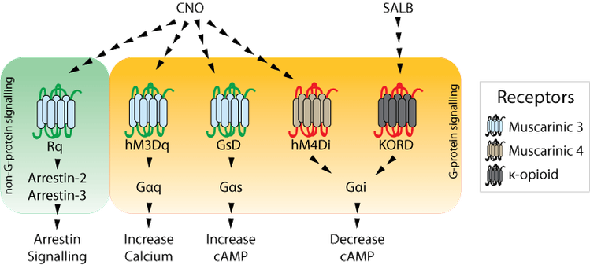
Linking Novelty Exploration & Cataplexy
AAV2-EF1α-DIO-hM4Dq (or hM4Di)-mCherry
Adeno-Associated Virus Serotype 2
Elongation Factor 1 alpha promoter
Conditional Gene Expression Sequence (Double-floxed Inverse Orientation)
DREADD
Protein Reporter
AAV2-SynI-iCre
Adeno-Associated Virus Serotype 2
Synapsin I Promoter (Neuron Specific)
Codon-Improved Cre Recombinase

Slide 43
Linking Novelty Exploration & Cataplexy
Hasegawa, E., et al. (2017). "Serotonin neurons in the dorsal raphe mediate the anticataplectic action of orexin neurons by reducing amygdala activity." Proceedings of the National Academy of Sciences 114(17): E3526.

Slide 44
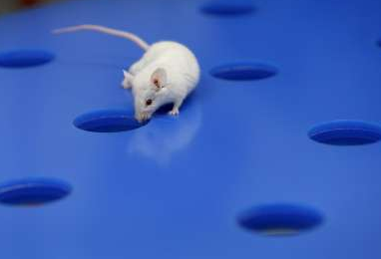
Linking Novelty Exploration & Cataplexy
How do these results compare?
Reduced Muscle Tone
Enhanced Muscle Tone
What does this say about the link between novelty exploration and cataplexy?
Normal movement
Behavioral
Arrest
Cataplexy
Catalepsy
Amygdala

Slide 45
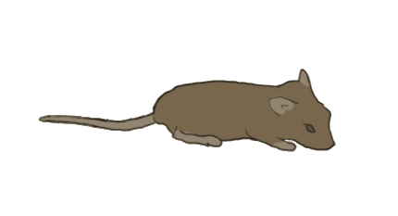
Linking Novelty Exploration & Cataplexy
LH
Amygdala
DR

Slide 46
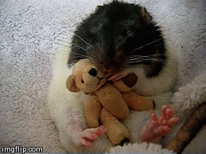
Linking Novelty Exploration & Cataplexy
LH
Amygdala
DR

Slide 47
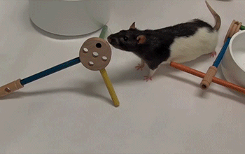
Linking Novelty Exploration & Cataplexy
LH
Amygdala
DR

Slide 48
Linking Novelty Exploration & Cataplexy
This suggests that inhibition of LA/BLA neurons reverses cataplexy-like behavior
AAV2-EF1α-DIO-hM4Di-mCherry
AAV2-SynI-iCre
Hasegawa, E., et al. (2017). "Serotonin neurons in the dorsal raphe mediate the anticataplectic action of orexin neurons by reducing amygdala activity." Proceedings of the National Academy of Sciences 114(17): E3526.

Slide 49
Linking Novelty Exploration & Cataplexy
Location-locked closed-loop signaling
Excitation (ChR)
Inhibition (Jaws)
This suggests that ARhGEF6-positive neurons in the BLA project to CeA neurons to promote behavioral arrests
Botta, P., et al. (2019). "An amygdala circuit mediates experience-dependent momentary exploratory arrests." bioRxiv: 797001.

Slide 50
Linking Novelty Exploration & Cataplexy
The Proposed Relationship
CeA
Neuron
Behavioral Arrest
BLA
ARhGEF6⁺

Slide 51
Linking Novelty Exploration & Cataplexy
The Proposed Relationship
CeA
Neuron
Freezing Behavior
BLA
ARhGEF6⁺
BLA
ARhGEF6⁻

Slide 52
Linking Novelty Exploration & Cataplexy
The Proposed Relationship
Cataplexy
CeA
Neuron
Normal Movements
Reward
Areas
70% of BLA pyramidal neurons receive tonic inhibition
So where do psychedelics fit in?
BLA
GABA
Serotonin Inputs
BLA
ARhGEF6⁺
BLA
ARhGEF6⁻
BLA
GABA
Marowsky, A., et al. (2012). "Tonic Inhibition in Principal Cells of the Amygdala: A Central Role for α3 Subunit-Containing GABAA Receptors." The journal of neuroscience 32(25): 8611-8619.
Rainnie, D. G. (1999). "Serotonergic modulation of neurotransmission in the rat basolateral amygdala." J Neurophysiol 82(1): 69-85.

Slide 53
Connecting Serotonergic Psychedelics
Hervig, M. E.-S., et al. (2017). "Involvement of serotonin 2A receptor activation in modulating medial prefrontal cortex and amygdala neuronal activation during novelty-exposure." Behavioural Brain Research 326: 1-12.

Slide 54
Connecting Serotonergic Psychedelics
Sham Lesion
mPFC Lesion
Measure c-Fos
Hervig, M. E.-S., et al. (2017). "Involvement of serotonin 2A receptor activation in modulating medial prefrontal cortex and amygdala neuronal activation during novelty-exposure." Behavioural Brain Research 326: 1-12.
Notes:
Excitotoxic lesion with NMDA – kills cell bodies, but leaves dendrites and axons in place.

Slide 55
Connecting Serotonergic Psychedelics
Hervig, M. E.-S., et al. (2017). "Involvement of serotonin 2A receptor activation in modulating medial prefrontal cortex and amygdala neuronal activation during novelty-exposure." Behavioural Brain Research 326: 1-12.

Slide 56
Connecting Serotonergic Psychedelics
Hervig, M. E.-S., et al. (2017). "Involvement of serotonin 2A receptor activation in modulating medial prefrontal cortex and amygdala neuronal activation during novelty-exposure." Behavioural Brain Research 326: 1-12.

Slide 57
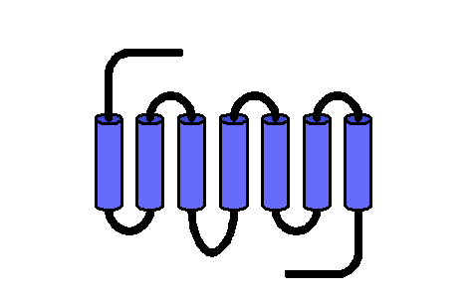
Connecting Serotonergic Psychedelics
Thoughts on psychedelics being therapeutic in this circuit?
dmPFC
Novelty Exploration
Normal or Enhanced Fear State
CeA
Neuron
Cataplexy-like Behavior
5-HT_{2A/B}
Reward
Areas
Serotonin Inputs
5-HT_{2A/B}
BLA
GABA
Serotonin Inputs
BLA
ARhGEF6⁺
BLA
ARhGEF6⁻
BLA
GABA
5-HT_{2A/B}

Slide 58
More (Potentially Useful) Information
5-HT_{5A} Knockout
Located in amygdala and PFC
Inhibitory (G_{i})
Grailhe, R., et al. (1999). "Increased exploratory activity and altered response to LSD in mice lacking the 5-HT5A receptor." Neuron 22(3): 581-591.

Slide 59
More (Potentially Useful) Information
Is there a difference between Novelty Exploration and Novelty-Seeking Behaviors?

Slide 60
More (Potentially Useful) Information
LR = Low Responders
HR = High Responders
LNP = Low Novelty Preference
HNP = High Novelty Preference
Belin, D., et al. (2011). "High-Novelty-Preference Rats are Predisposed to Compulsive Cocaine Self-administration." Neuropsychopharmacology 36(3): 569-579.
Notes:
High responders – high locomotor activity in a novel inescapable environment
High Novelty Preference – prefer novel environment over familiar environment

Slide 61
Take Home Messages
Serotonergic psychedelics can impact novelty exploration
Affect is on 5-HT₂ receptors in dmPFC
Affect may also be linked to 5-HT_{5A} receptors in PFC or BLA
Serotonergic psychedelics can induce changes in muscle tone
- Affect is potentially on 5-HT₂ receptors on GABAergic BLA cells
Cataplexy and Novelty Exploration circuits are connected

